Slide 1
Predicting Toronto AirBnB Prices
Sixing Cao, Tian Gan, Yun Sum Wong, Tiffany Yeung

Slide 2
Objective
Analyzing Airbnb data for Toronto to predict the price of an Airbnb rentals in different neighborhoods in Toronto using machine learning techniques discussed in class (Linear regression, Lasso regression, Random Forest regressor) .

Slide 3
Assumptions and Methodologies I
Assumptions:
Higher number of reviews mean that more people stayed at the Airbnb and more people saw the listing
Data cleaning:
Dropped airbnbs listed higher than $700 as outliers (4.64% of the data)
Filled in nulls with character values (e.g. columns such as “last_review” or “reviews_per_month”)
10 features including:
Community Council
Room_type
Price
min # of nights
# of reviews, reviews/month
availability
Name length
Calculated host listings count

Slide 4
Assumptions and Methodologies II
Used one hot encoding to convert categorical features into binary dummy variables (features: room_type, community council)
Apply linear regression model to have a baseline to compare other models (lasso generator and random forest generator)

Slide 5
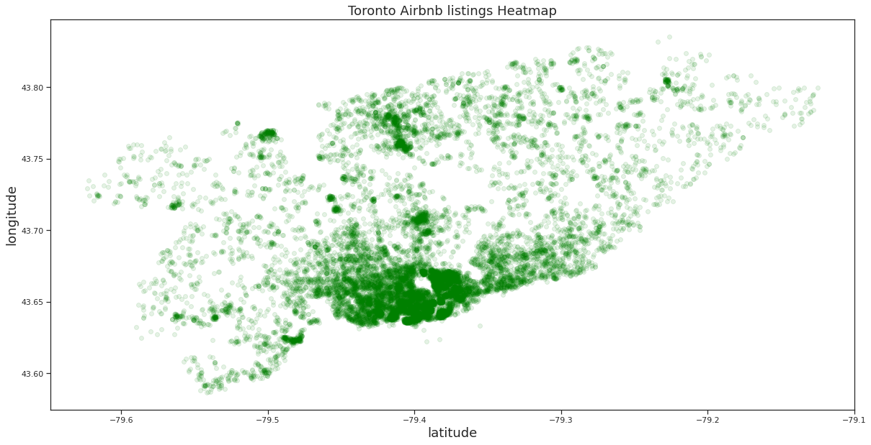
Results and Discussion - Listings Heatmap

Slide 6
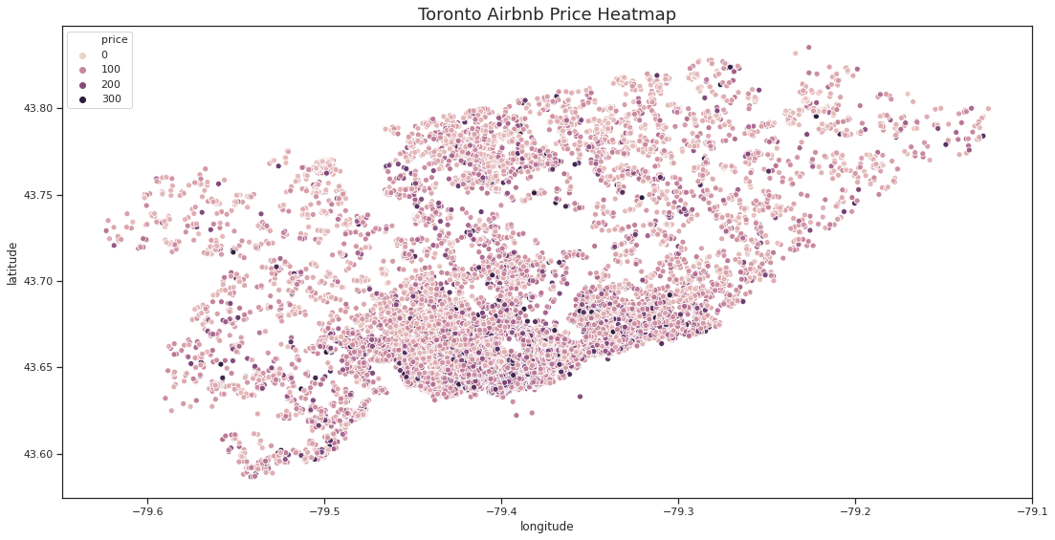
Results and Discussion - Prices Heatmap
Notes:
Price is everywhere

Slide 7
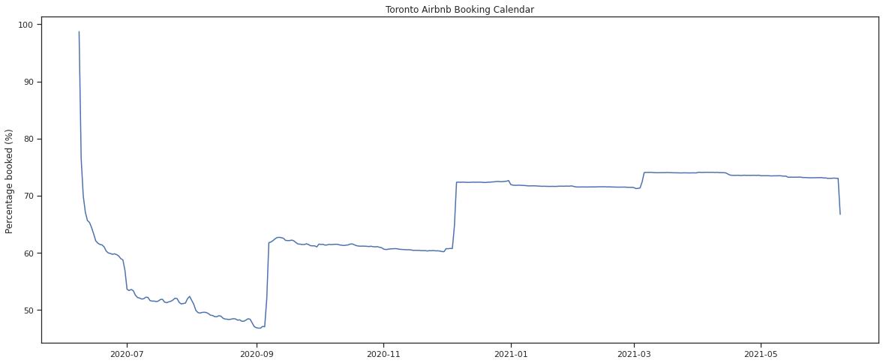
Results and Discussion - Predicted Booking Calendar

Slide 8
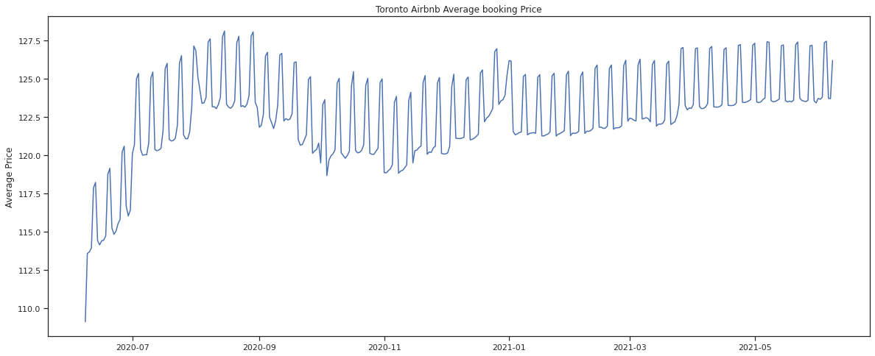
Results and Discussion - Predicted Avg Price

Slide 9
Results and Discussion
Linear regression model:
RMSE: 49.21, r-squared of 0.339
Seems to be an issue with multicollinearity between features (cond. #: 3.34e+03)
Data seems to be skewed (1.03) and deviation from normal distribution (kurtosis @4.189 vs of normal distribution would be@3)
Condition number @3.34e+03
Due to strong multicollinearity, we tried Lasso Regression to select a subset of parameters:
RMSE: 47.78, r-squared 0.377
This regularised model did way better than normal linear regression
Notes:
Lasso regression - linear regression that uses shrinkage

Slide 10
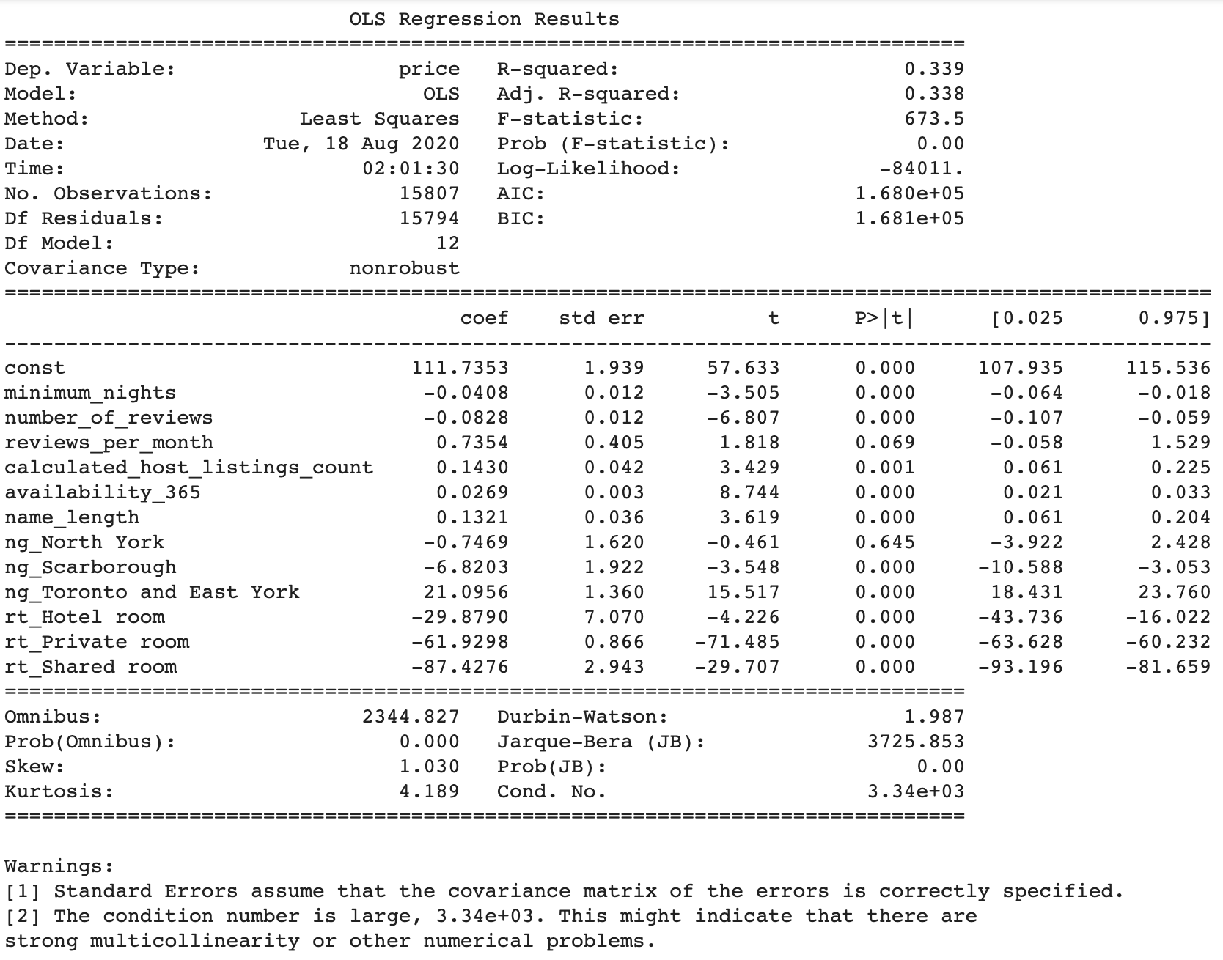
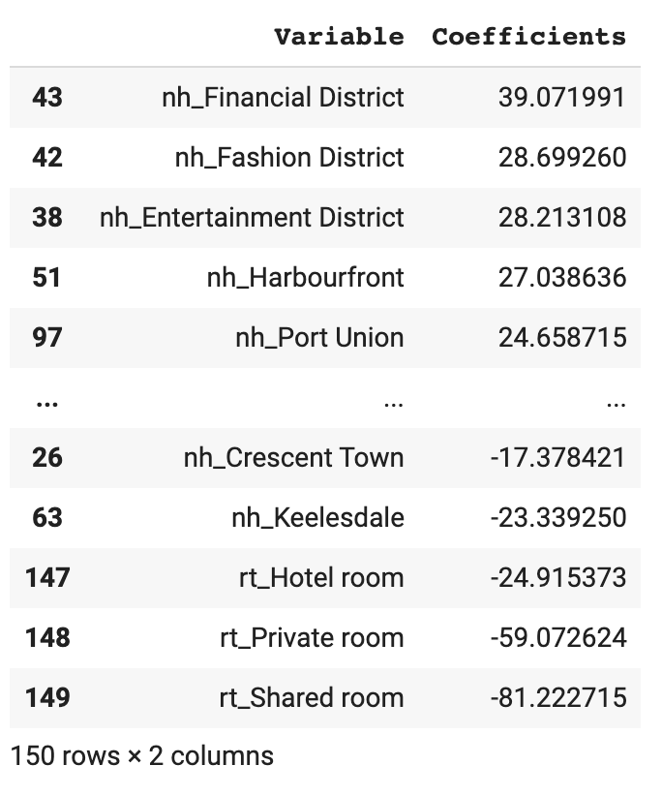
Results and Discussion
Linear Regression
Lasso Regression

Slide 11
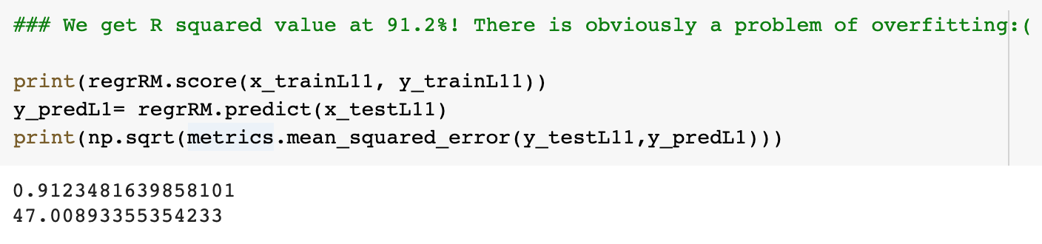
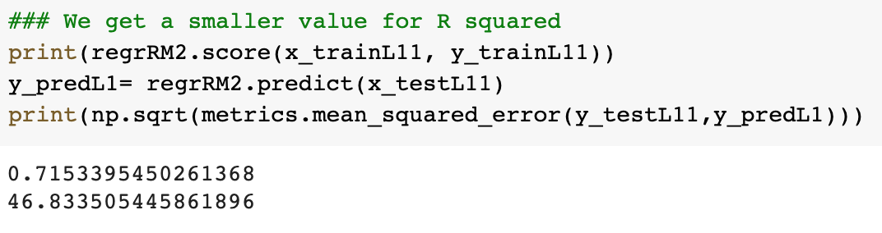
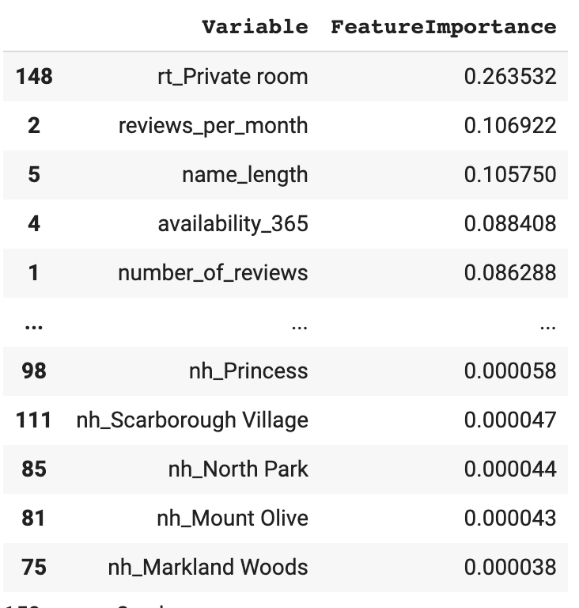
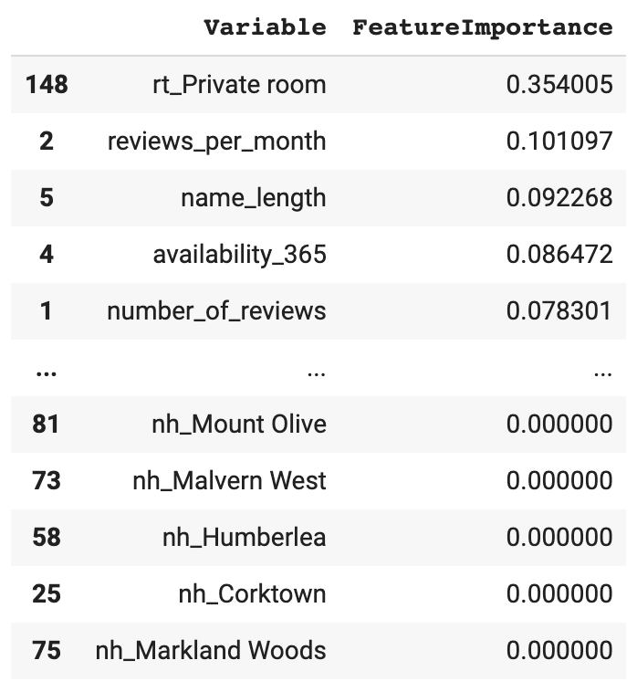
Results and Discussion
Random forest generator:
Overall bias reduced because each tree is trained on a subset of data
Functions well with categorical data
Applying feature importance, we were able to determine the features that have the most weight
Found that private room, reviews/month, name length, and 365 availability had the most influence on the price
RandomForestRegressor(n_estimators=300)
RandomForestRegressor(n_estimators=200, max_depth = 50, min_samples_split = 5,min_samples_leaf =4)

Slide 12
Challenges!
Too many variables of neighbourhood values pointing to the same neighbourhood, e.g. Toronto
Data aggregation for neighbourhood values, need different datasource to categorize small location to higher level (community council)
Dealing with rooms that have a high minimum number of nights

Slide 13
Lessons Learnt
A lot of more time than expected is needed to clean and make sense of real data
There is no one correct way of analyzing the data, and finding the correct model is based on experience and trial and error
Feature importance is essential to ensuring your model is not overfit

